Slide 1
Intersection of Three Planes

Slide 2
In talking about the intersection of three planes, we will be talking about three equations with three unknowns.

Slide 3
Recall from earlier that when discussing systems of equations, we can talk about consistent and inconsistent systems.
Consistent system: A system of equations with at least one solution that satisfies each equation. In the case of the intersection of three planes, this means that there is at least one point of intersection. We will see that three planes can intersect at a single point, along a line of intersection, or at the whole plane of intersection.

Slide 4
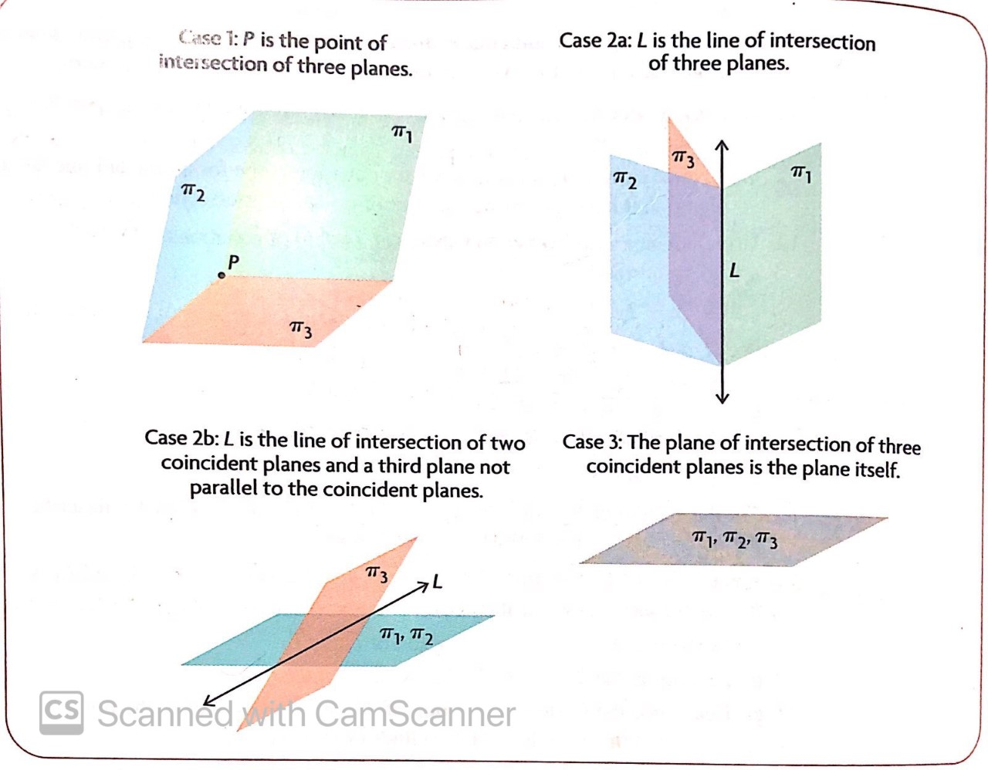
Consistent Systems

Slide 5
Consistent Systems
Three planes can intersect at a single point.
Three non-parallel planes can intersect along a line.
Two coincident planes can intersect a third plane along a line (much like two non-parallel planes intersecting along a line).
Three coincident planes.

Slide 6
Inconsistent system: A system of equations in which there is no one solution that satisfies each equation. In the case of the intersection of three planes, this means that there is no one point of intersection.

Slide 7
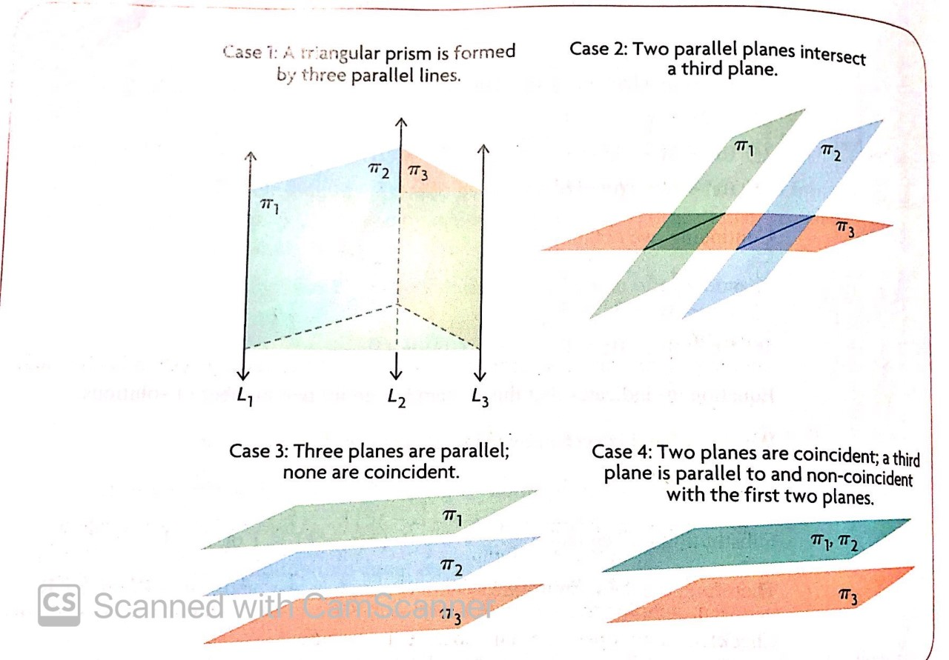
Inconsistent Systems

Slide 8
Inconsistent Systems
Three non-parallel planes can intersect along three parallel lines of intersection (forming a triangular prism).
Two parallel, non-coincident planes each intersect a third non-parallel plane.
Three parallel, non-coincident planes.
Two parallel, coincident planes and another parallel, non-coincident plane.

Slide 9
Steps to Determine which of the 8 scenarios is present at any time.

Slide 10
Convert each of the planes to Cartesian form (if necessary).
Determine whether any of the normal vectors are parallel.
If none of the normal vectors are parallel, then we have either one single point of intersection, or three non-parallel planes that intersect along a line, or a triangular prism with 0 points of intersection.
4. We then build a matrix and solve to determine which scenario we have

Slide 11
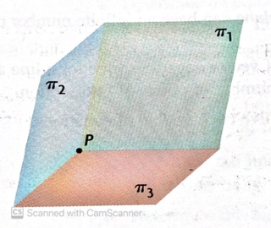
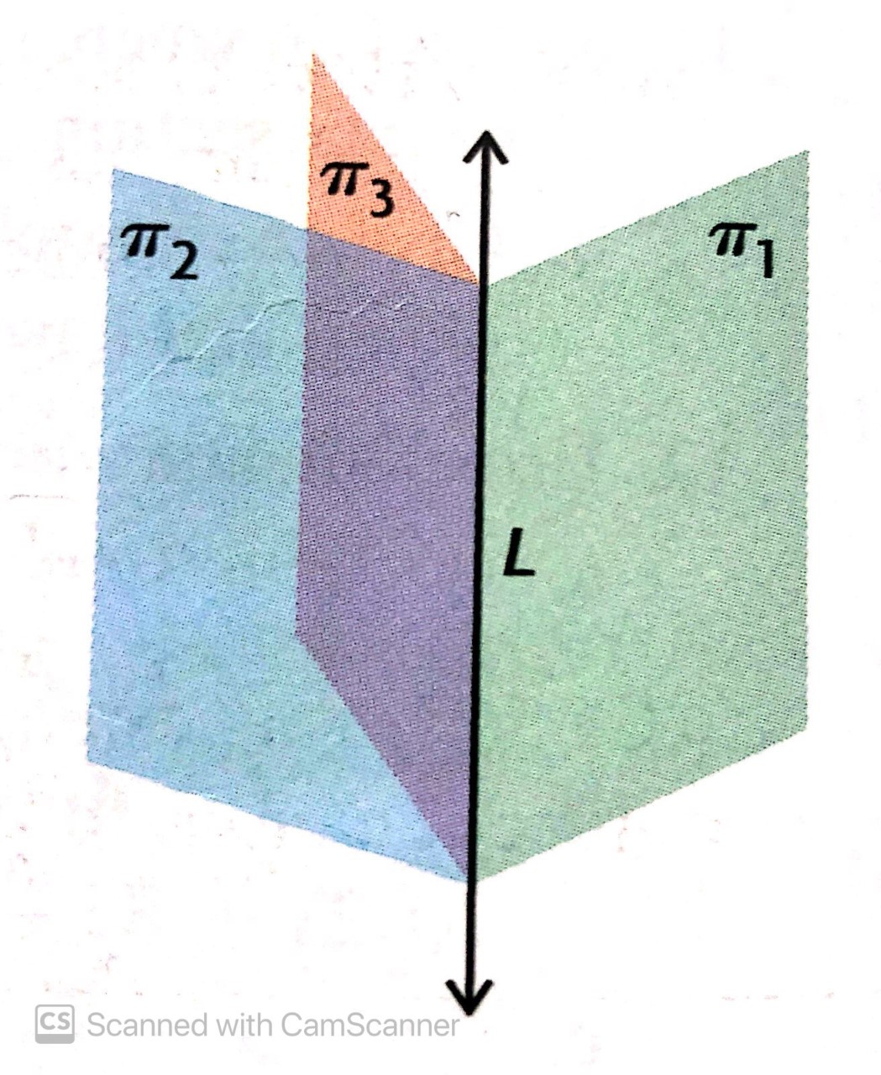
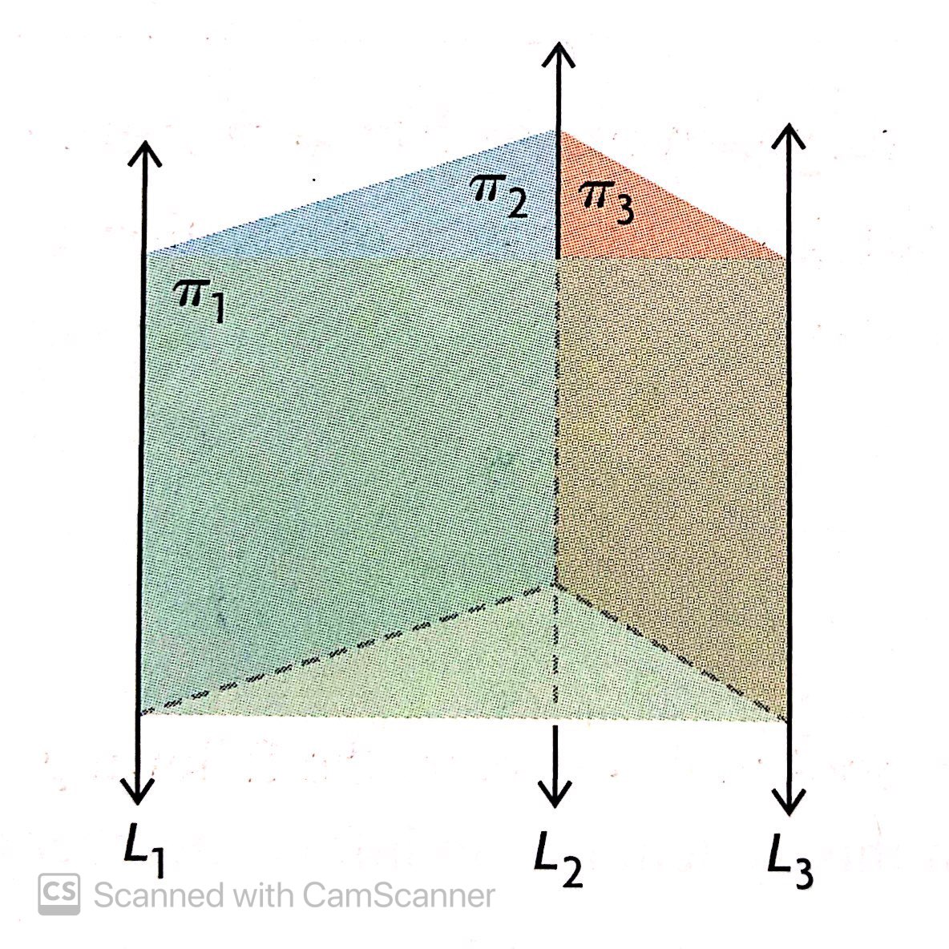
Convert each of the planes to Cartesian form (if necessary).
Determine whether any of the normal vectors are parallel.
If none of the normal vectors are parallel, then we have either one single point of intersection, or three non-parallel planes that intersect along a line, or a triangular prism with 0 points of intersection.
4. We then build a matrix and solve to determine which scenario we have

Slide 12
5. If we get a single point of intersection, we have the first scenario pictured. We then determine the point of intersection
6. If we get a final row of 0 0 0 0, then we have infinite points of intersection, and we are dealing with the second scenario listed below. We can ignore the third row of the matrix and determine the equation of the line of intersection by focusing only on the top two rows of the matrix.
7. If we get a final row of 0 0 0 non-zero, then we have zero points of intersection and we have the third scenario shown

Slide 13
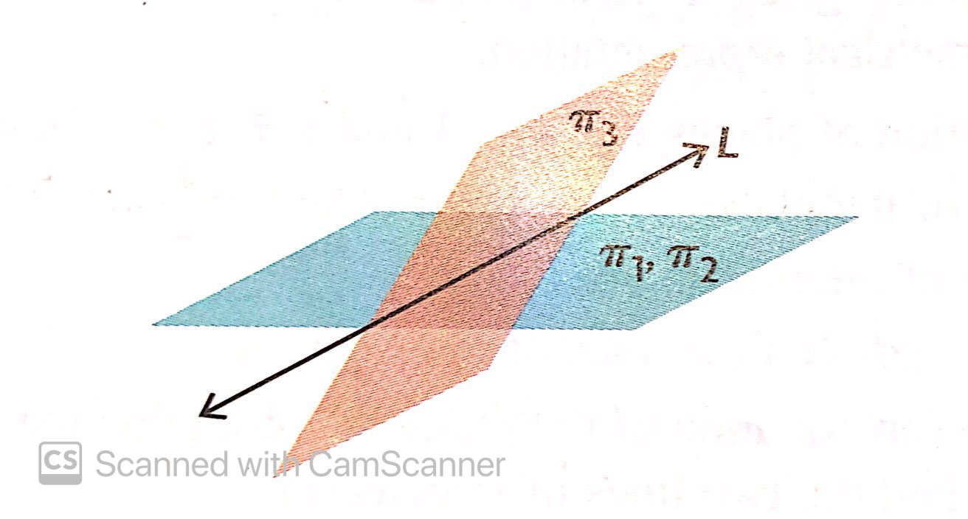
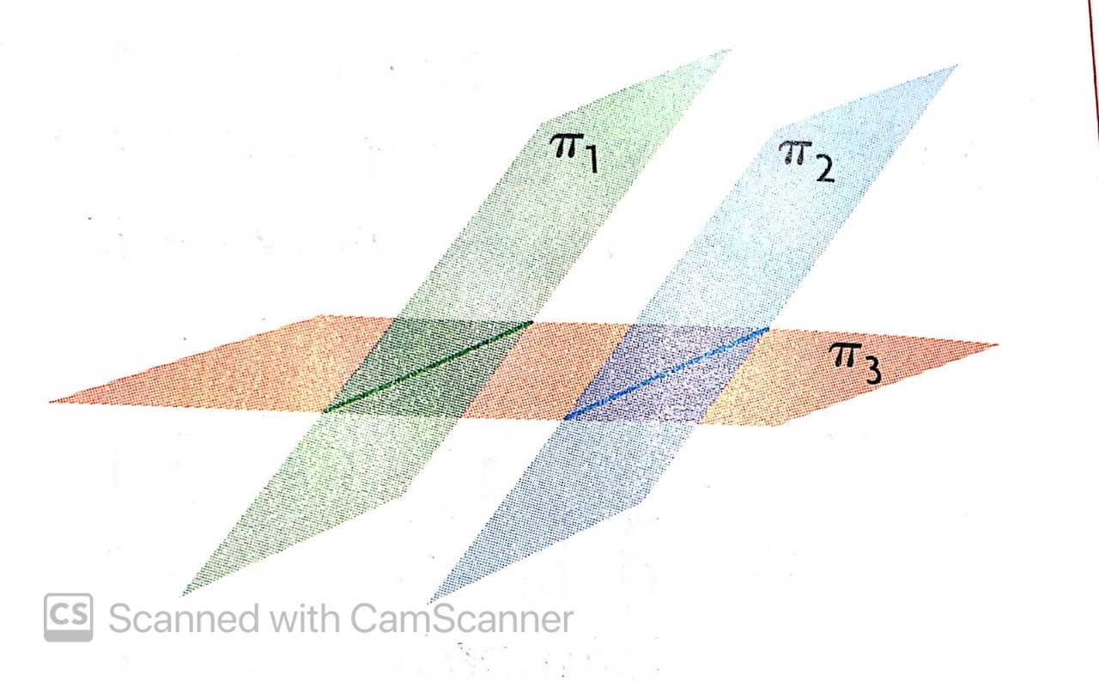
What if 2 normal vectors are parallel and the third is not?
Determine whether the two planes with normal vectors are coincident or non-coincident.
If the planes are coincident, then the third non-parallel plane intersects the two coincident planes along a line. (first situation illustrated below). To determine the equation of the line of intersection, we can discard one of the two coincident planes. Then we build a matrix and determine the equation of the line of intersection between the remaining plane of those two and the third plane.

Slide 14
10. If the two planes are parallel and non-coincident, then the third non-parallel plane intersects each of them along a separate line of intersection. The system is inconsistent, and no further work needs to be done.

Slide 15
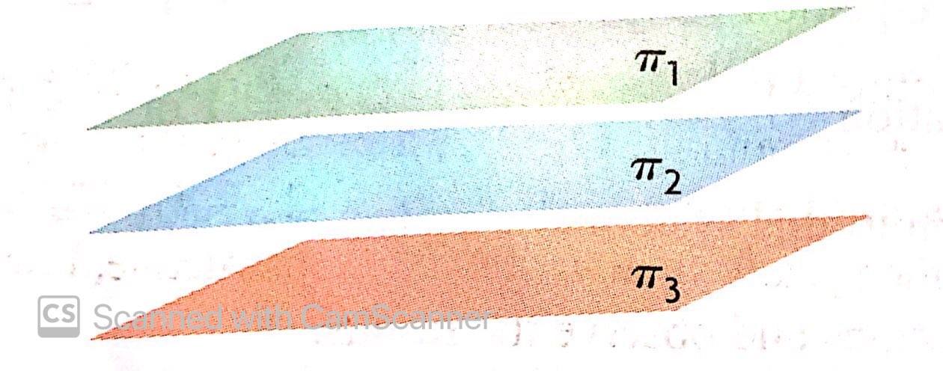
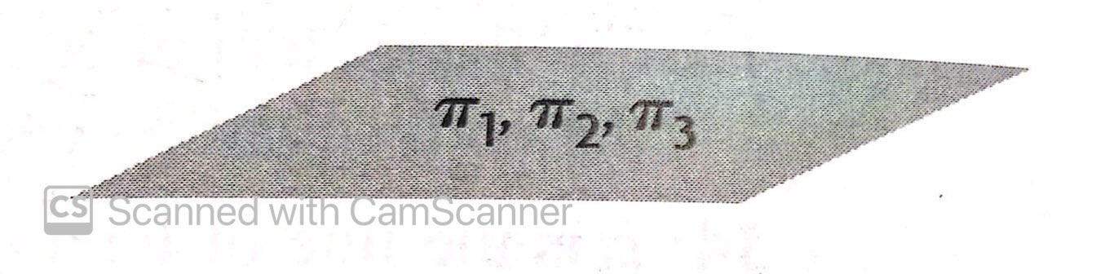
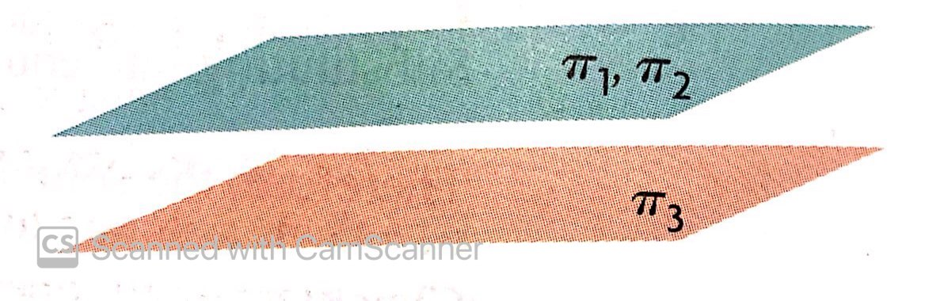
What if all 3 of the normal vectors are parallel?
Determine whether any of the planes are also coincident.
If all three planes are coincident, then we have a consistent system (first diagram shown). The points of intersection are every point on the plane. There is no further work to be done.
If two of the planes are coincident and the third is non-coincident, then there are no points of intersection (second diagram shown). It is an inconsistent system. No further work to be done.
If all three planes are non-coincident, then there are no points of intersection. It is an inconsistent system (third diagram shown).

Slide 16

Example
Solve the following system of equations.
$x+y−3z+23=0$
$5x−4y+2z−14=0$
$2x+3y−z+19=0$

Slide 17
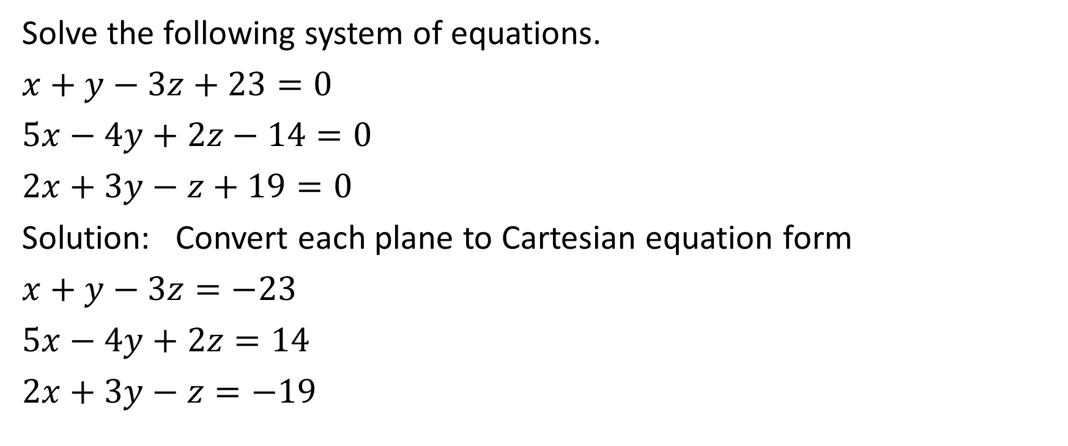
Solve the following system of equations.
$x+y−3z+23=0$
$5x−4y+2z−14=0$
$2x+3y−z+19=0$
Solution: Convert each plane to Cartesian equation form
$x+y−3z=−23$
$5x−4y+2z=14$
$2x+3y−z=−19$

Slide 18
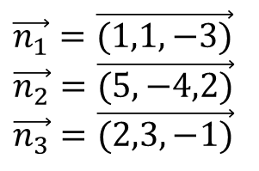
Solve the following system of equations.
$x+y−3z+23=0$
$5x−4y+2z−14=0$
$2x+3y−z+19=0$
Solution: Convert each plane to Cartesian equation form
$x+y−3z=−23$
$5x−4y+2z=14$
$2x+3y−z=−19$
$\vec{n_{1}}=\vec{(1,1,−3)}$
$\vec{n_{2}}=\vec{(5,−4,2)}$
$\vec{n_{3}}=\vec{(2,3,−1)}$

Slide 19
Solve the following system of equations.
$x+y−3z+23=0$
$5x−4y+2z−14=0$
$2x+3y−z+19=0$
Solution: Convert each plane to Cartesian equation form
$x+y−3z=−23$
$5x−4y+2z=14$
$2x+3y−z=−19$
$\vec{n_{1}}=\vec{(1,1,−3)}$
$\vec{n_{2}}=\vec{(5,−4,2)}$
$\vec{n_{3}}=\vec{(2,3,−1)}$
None of the planes are parallel, so we should do some matrix work.

Slide 20
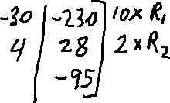




Solve the following system of equations.
$x+y−3z+23=0$
$5x−4y+2z−14=0$
$2x+3y−z+19=0$

Slide 21
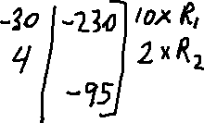
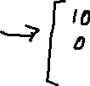

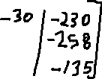
Solve the following system of equations.
$x+y−3z+23=0$
$5x−4y+2z−14=0$
$2x+3y−z+19=0$

Slide 22
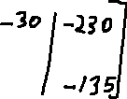
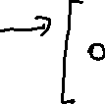



Solve the following system of equations.
$x+y−3z+23=0$
$5x−4y+2z−14=0$
$2x+3y−z+19=0$

Slide 23

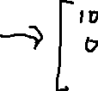

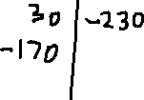

Solve the following system of equations.
$x+y−3z+23=0$
$5x−4y+2z−14=0$
$2x+3y−z+19=0$

Slide 24






Solve the following system of equations.
$x+y−3z+23=0$
$5x−4y+2z−14=0$
$2x+3y−z+19=0$

Slide 25
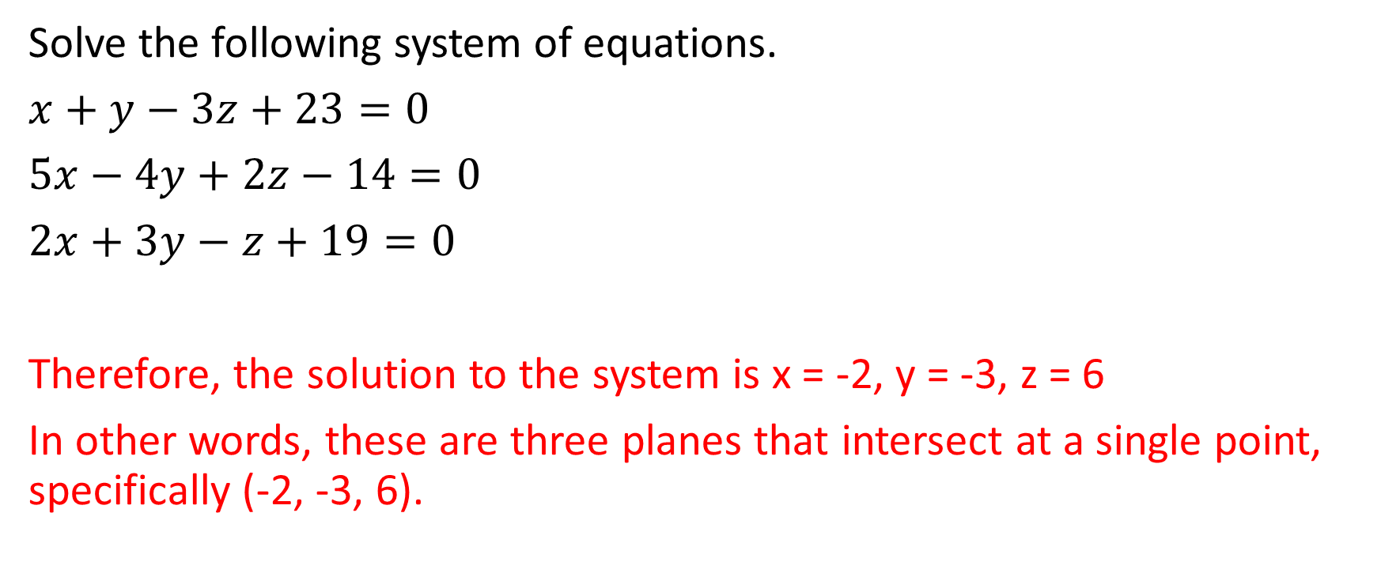
Solve the following system of equations.
$x+y−3z+23=0$
$5x−4y+2z−14=0$
$2x+3y−z+19=0$
Therefore, the solution to the system is x = -2, y = -3, z = 6
In other words, these are three planes that intersect at a single point, specifically (-2, -3, 6).

Slide 26

Example
Solve the following system of equations
$3x−4y+10z=−22$
$x+2y=16$
$x−8y+10z=−54$

Slide 27
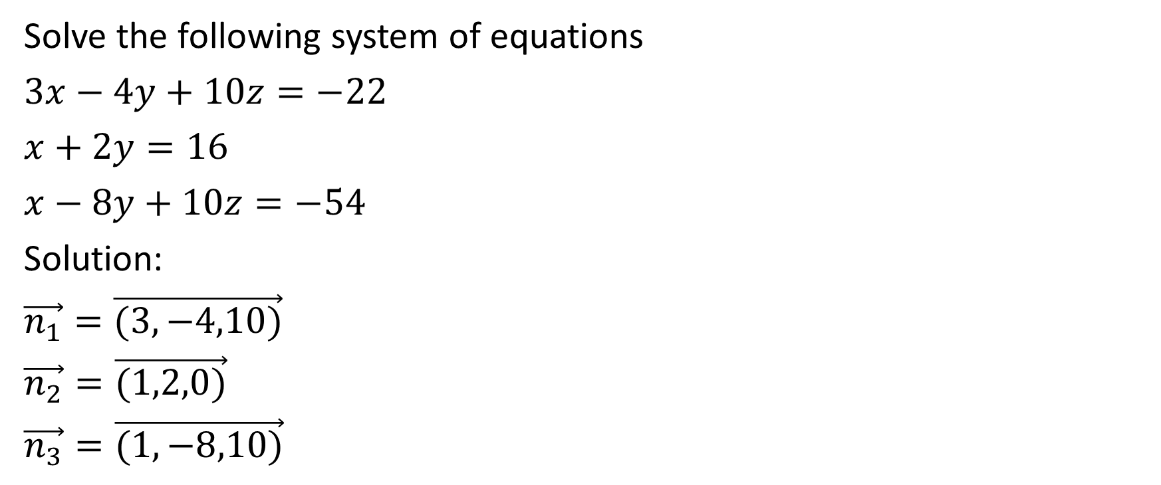
Solve the following system of equations
$3x−4y+10z=−22$
$x+2y=16$
$x−8y+10z=−54$
Solution:
$\vec{n_{1}}=\vec{(3,−4,10)}$
$\vec{n_{2}}=\vec{(1,2,0)}$
$\vec{n_{3}}=\vec{(1,−8,10)}$

Slide 28
Solve the following system of equations
$3x−4y+10z=−22$
$x+2y=16$
$x−8y+10z=−54$
Solution:
$\vec{n_{1}}=\vec{(3,−4,10)}$
$\vec{n_{2}}=\vec{(1,2,0)}$
$\vec{n_{3}}=\vec{(1,−8,10)}$
Since none of the normal vectors are parallel (i.e., none of them are scalar multiples of each other), then we should build a matrix and solve it.

Slide 29
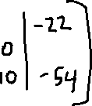

Solve the following system of equations
$3x−4y+10z=−22$
$x+2y=16$
$x−8y+10z=−54$

Slide 30
Solve the following system of equations
$3x−4y+10z=−22$
$x+2y=16$
$x−8y+10z=−54$
Ordinarily at this point we try to eliminate x-component of the last two rows. However, we don’t always have to do that. In this case, since one of the entries in the z-column is already a zero, it might be slightly less work to eliminate the last entry in the z-column. We’ll try that this time. However, we could do what we usually do and eliminate the x-components of the last two rows if we prefer.

Slide 31



Solve the following system of equations
$3x−4y+10z=−22$
$x+2y=16$
$x−8y+10z=−54$

Slide 32


Solve the following system of equations
$3x−4y+10z=−22$
$x+2y=16$
$x−8y+10z=−54$

Slide 33
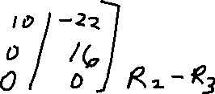


Solve the following system of equations
$3x−4y+10z=−22$
$x+2y=16$
$x−8y+10z=−54$

Slide 34
Solve the following system of equations
$3x−4y+10z=−22$
$x+2y=16$
$x−8y+10z=−54$
It is ok to have a triangle of zeros in this position

Slide 35
Solve the following system of equations
$3x−4y+10z=−22$
$x+2y=16$
$x−8y+10z=−54$
Notice that the last row is all zeros. This means that 0x + 0y + 0z = 0. We can eliminate this row from consideration because it adds nothing to the answer, and simply solve the matrix containing the first two rows.

Slide 36
Solve the following system of equations
$3x−4y+10z=−22$
$x+2y=16$
$x−8y+10z=−54$

Slide 37
Solve the following system of equations
$3x−4y+10z=−22$
$x+2y=16$
$x−8y+10z=−54$
Looking at the last row, we have x + 2y = 16. Let’s solve for one point on that line by assigning a random value to either x or y and solving for the other.

Slide 38


Solve the following system of equations
$3x−4y+10z=−22$
$x+2y=16$
$x−8y+10z=−54$

Slide 39
Solve the following system of equations
$3x−4y+10z=−22$
$x+2y=16$
$x−8y+10z=−54$
Therefore, there is a point on the line of intersection with an x-value of 0 and a y-value of 8. To determine the z-value, we will put those values into the equation in the first row.

Slide 40








Solve the following system of equations
$3x−4y+10z=−22$
$x+2y=16$
$x−8y+10z=−54$

Slide 41
Solve the following system of equations
$3x−4y+10z=−22$
$x+2y=16$
$x−8y+10z=−54$
To determine the direction vector, we can determine the cross product of any two normal vectors

Slide 42
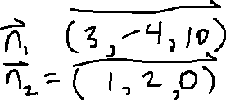

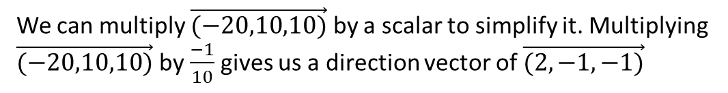
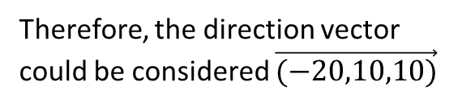



Solve the following system of equations
$3x−4y+10z=−22$
$x+2y=16$
$x−8y+10z=−54$
To determine the direction vector, we can determine the cross product of any two normal vectors
Therefore, the direction vector could be considered $\vec{(−20,10,10)}$
We can multiply $\vec{(−20,10,10)}$ by a scalar to simplify it. Multiplying $\vec{(−20,10,10)}$ by $\frac{−1}{10}$ gives us a direction vector of $\vec{(2,−1,−1)}$

Slide 43
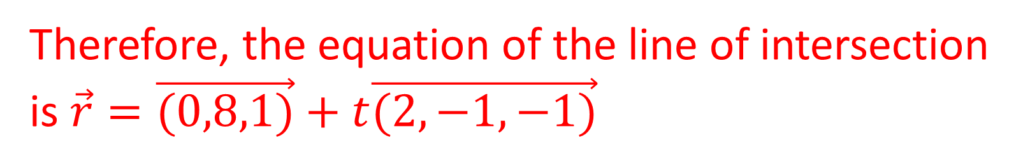
Solve the following system of equations
$3x−4y+10z=−22$
$x+2y=16$
$x−8y+10z=−54$
Therefore, the equation of the line of intersection is $\vec{r}=\vec{(0,8,1)}+t\vec{(2,−1,−1)}$

Slide 44

Example
Solve the following system of equations
$4x+2y−z=12$
$x−3y+5z=11$
$19x+5y+2z=0$

Slide 45

Solve the following system of equations
$4x+2y−z=12$
$x−3y+5z=11$
$19x+5y+2z=0$
Solution:
$\vec{n_{1}}=\vec{(4,2,−1)}$
$\vec{n_{2}}=\vec{(1,−3,5)}$
$\vec{n_{3}}=\vec{(19,5,2)}$

Slide 46
Solve the following system of equations
$4x+2y−z=12$
$x−3y+5z=11$
$19x+5y+2z=0$
Solution:
$\vec{n_{1}}=\vec{(4,2,−1)}$
$\vec{n_{2}}=\vec{(1,−3,5)}$
$\vec{n_{3}}=\vec{(19,5,2)}$
None of the normal vectors are parallel, so we need to construct a matrix

Slide 47


Solve the following system of equations
$4x+2y−z=12$
$x−3y+5z=11$
$19x+5y+2z=0$
The numbers in column 3 are a bit more friendly than the numbers in either column 1 or column 2 to try to eliminate, so we will get each of the components in column 3 to have the same magnitude

Slide 48
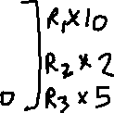


Solve the following system of equations
$4x+2y−z=12$
$x−3y+5z=11$
$19x+5y+2z=0$

Slide 49
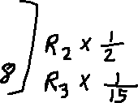





Solve the following system of equations
$4x+2y−z=12$
$x−3y+5z=11$
$19x+5y+2z=0$

Slide 50



Solve the following system of equations
$4x+2y−z=12$
$x−3y+5z=11$
$19x+5y+2z=0$

Slide 51
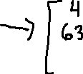


Solve the following system of equations
$4x+2y−z=12$
$x−3y+5z=11$
$19x+5y+2z=0$

Slide 52
Solve the following system of equations
$4x+2y−z=12$
$x−3y+5z=11$
$19x+5y+2z=0$
The last row states that 0x + 0y + 0z = 141.
This is not possible.
Therefore there are no points of intersection.

Slide 53
Solve the following system of equations
$4x+2y−z=12$
$x−3y+5z=11$
$19x+5y+2z=0$
The last row states that 0x + 0y + 0z = 141.
This is not possible.
Therefore there are no points of intersection.
Therefore this is an inconsistent system with three planes that form a triangular prism.

Slide 54

Example 4
Solve the following system of equations
$3x+2y+2z=22$
$x−4y+6z=15$
$6x+4y+4z=44$

Slide 55
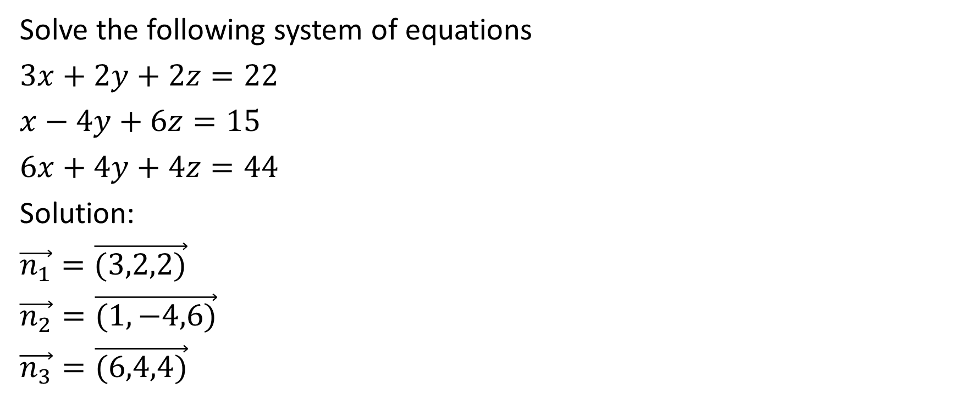
Solve the following system of equations
$3x+2y+2z=22$
$x−4y+6z=15$
$6x+4y+4z=44$
Solution:
$\vec{n_{1}}=\vec{(3,2,2)}$
$\vec{n_{2}}=\vec{(1,−4,6)}$
$\vec{n_{3}}=\vec{(6,4,4)}$

Slide 56

Solve the following system of equations
$3x+2y+2z=22$
$x−4y+6z=15$
$6x+4y+4z=44$
Solution:
$\vec{n_{1}}=\vec{(3,2,2)}$
$\vec{n_{2}}=\vec{(1,−4,6)}$
$\vec{n_{3}}=\vec{(6,4,4)}$
Two of the normal vectors are parallel, and since the D values maintain the same multiple, the planes are coincident.
In other words $π_{1}$ and $π_{3}$ are coincident.
However, the other plane is not parallel.
We will remove one of the two coincident planes, and merely find the equation of the line of intersection of the other two planes, thus giving us the equation of the line of intersection of all three planes.

Slide 57





Solve the following system of equations
$3x+2y+2z=22$
$x−4y+6z=15$
$6x+4y+4z=44$

Slide 58



Solve the following system of equations
$3x+2y+2z=22$
$x−4y+6z=15$
$6x+4y+4z=44$

Slide 59
Solve the following system of equations
$3x+2y+2z=22$
$x−4y+6z=15$
$6x+4y+4z=44$
Now, let’s determine a value of y and a value of z that satisfy the equation 14y - 16z = -23

Slide 60
Solve the following system of equations
$3x+2y+2z=22$
$x−4y+6z=15$
$6x+4y+4z=44$
Now, let’s determine a value of y and a value of z that satisfy the equation 14y - 16z = -23

Slide 61




Solve the following system of equations
$3x+2y+2z=22$
$x−4y+6z=15$
$6x+4y+4z=44$
Now, let’s determine a value of y and a value of z that satisfy the equation 14y - 16z = -23

Slide 62
Solve the following system of equations
$3x+2y+2z=22$
$x−4y+6z=15$
$6x+4y+4z=44$
Now, let’s determine a value of y and a value of z that satisfy the equation 14y - 16z = -23
Now, substitute that y value and that z value in to the equation in the top row

Slide 63








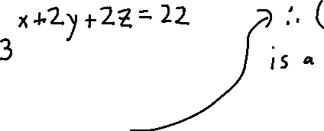
Solve the following system of equations
$3x+2y+2z=22$
$x−4y+6z=15$
$6x+4y+4z=44$
Now, let’s determine a value of y and a value of z that satisfy the equation 14y - 16z = -23
Now, substitute that y value and that z value in to the equation in the top row

Slide 64
Solve the following system of equations
$3x+2y+2z=22$
$x−4y+6z=15$
$6x+4y+4z=44$
To determine the direction vector, we could determine the cross product of the normal vector of either of the coincident planes with the normal vector of the other non-coincident plane.
Let’s choose to find the cross product of the normal vectors of the first and second plane.

Slide 65






Solve the following system of equations
$3x+2y+2z=22$
$x−4y+6z=15$
$6x+4y+4z=44$
We could say that the direction vector is $\vec{(20,−16,−14)}$, but let’s multiply that by $\frac{1}{2}$.
Therefore, let’s say that the direction vector is $\vec{(10,−8,−7)}$

Slide 66

Solve the following system of equations
$3x+2y+2z=22$
$x−4y+6z=15$
$6x+4y+4z=44$
We could say that thedirection vector is $\vec{(20,−16,−14)}$, but let’s multiply that by $\frac{1}{2}$.
Therefore, let’s say that the direction vector is $\vec{(10,−8,−7)}$

Slide 67
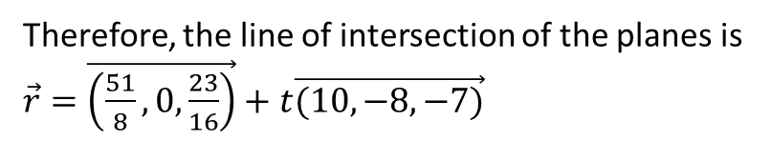
Solve the following system of equations
$3x+2y+2z=22$
$x−4y+6z=15$
$6x+4y+4z=44$
Therefore, the line of intersection of the planes is $\vec{r}=\vec{\left(\frac{51}{8},0,\frac{23}{16}\right)}+t\vec{(10,−8,−7)}$
Make sure that you don’t multiply the position vector by 16 to “simplify” it. You can do that with the direction vector but not the position vector.

Slide 68
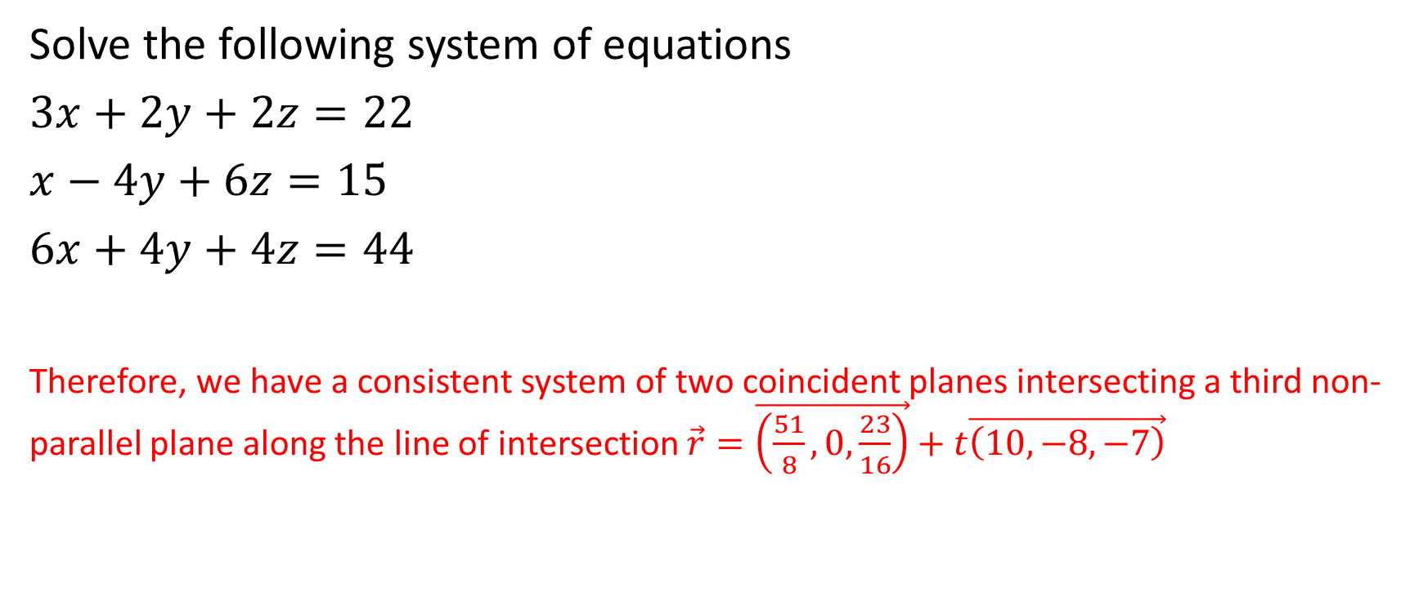
Solve the following system of equations
$3x+2y+2z=22$
$x−4y+6z=15$
$6x+4y+4z=44$
Therefore, we have a consistent system of two coincident planes intersecting a third non-parallel plane along the line of intersection $\vec{r}=\vec{\left(\frac{51}{8},0,\frac{23}{16}\right)}+t\vec{\left(10,−8,−7\right)}$

Slide 69

Example 5
Solve the system of equations
$5x−11y+17z−90=0$
$15x−33y+51z−200=0$
$3x−8y+2z−1=0$

Slide 70

Solve the system of equations
$5x−11y+17z−90=0$
$15x−33y+51z−200=0$
$3x−8y+2z−1=0$
Solution:
$\vec{n_{1}}=\vec{\left(5,−11,17\right)}$
$\vec{n_{2}}=\vec{\left(15,−33,51\right)}$
$\vec{n_{3}}=\vec{\left(3,−8,2\right)}$

Slide 71
Solve the system of equations
$5x−11y+17z−90=0$
$15x−33y+51z−200=0$
$3x−8y+2z−1=0$
Solution:
$\vec{n_{1}}=\vec{\left(5,−11,17\right)}$
$\vec{n_{2}}=\vec{\left(15,−33,51\right)}$
$\vec{n_{3}}=\vec{\left(3,−8,2\right)}$
The normal vectors to the first and second planes are scalar multiples, meaning that the planes are parallel. However, the D values do not maintain the same multiple, meaning that the planes are parallel and non-coincident.
Therefore, the three planes represent an inconsistent system with two parallel, non-coincident planes and a third non-parallel plane that intersects each of the other two planes.

Slide 72

Example 6
Solve the system of equations
$2x−9y+4z−15=0$
$4x−18y+8z−30=0$
$8x−36y+16z−60=0$

Slide 73

Solve the system of equations
$2x−9y+4z−15=0$
$4x−18y+8z−30=0$
$8x−36y+16z−60=0$
Solution:
$\vec{n_{1}}=\vec{\left(2,−9,4\right)}$
$\vec{n_{2}}=\vec{\left(4,−18,8\right)}$
$\vec{n_{3}}=\vec{\left(8,−36,16\right)}$

Slide 74
Solve the system of equations
$2x−9y+4z−15=0$
$4x−18y+8z−30=0$
$8x−36y+16z−60=0$
Solution:
$\vec{n_{1}}=\vec{\left(2,−9,4\right)}$
$\vec{n_{2}}=\vec{\left(4,−18,8\right)}$
$\vec{n_{3}}=\vec{\left(8,−36,16\right)}$
The three normal vectors are all scalar multiples of each other and the D values maintain their respective multiples. Therefore, these are three coincident planes
We have a consistent system with three coincident planes

Slide 75

Example 7
Solve the system of equations
$5x−y−z−15=0$
$10x−2y−2z−30=0$
$15x−3y−3z−50=0$

Slide 76

Solve the system of equations
$5x−y−z−15=0$
$10x−2y−2z−30=0$
$15x−3y−3z−50=0$
Solution:
$\vec{n_{1}}=\vec{\left(5,−1,−1\right)}$
$\vec{n_{2}}=\vec{\left(10,−2,−2\right)}$
$\vec{n_{3}}=\vec{\left(15,−3,−3\right)}$

Slide 77
Solve the system of equations
$5x−y−z−15=0$
$10x−2y−2z−30=0$
$15x−3y−3z−50=0$
Solution:
$\vec{n_{1}}=\vec{\left(5,−1,−1\right)}$
$\vec{n_{2}}=\vec{\left(10,−2,−2\right)}$
$\vec{n_{3}}=\vec{\left(15,−3,−3\right)}$
All three normal vectors are scalar multiples of each other, meaning all three planes are parallel. The D values for the first and second plane maintain the multiple, but the D value for the third plane does not maintain the D value.

Slide 78
Solve the system of equations
$5x−y−z−15=0$
$10x−2y−2z−30=0$
$15x−3y−3z−50=0$
Solution:
$\vec{n_{1}}=\vec{\left(5,−1,−1\right)}$
$\vec{n_{2}}=\vec{\left(10,−2,−2\right)}$
$\vec{n_{3}}=\vec{\left(15,−3,−3\right)}$
All three normal vectors are scalar multiples of each other, meaning all three planes are parallel. The D values for the first and second plane maintain the multiple, but the D value for the third plane does not maintain the D value.
Therefore, we have an inconsistent system with two coincident planes and a third parallel, non-coincident plane.

Slide 79

Example 8
Solve the system of equations
$x+4y−4z−13=0$
$10x+40y−40z−40=0$
$3x+12y−12z−18=0$

Slide 80

Solve the system of equations
$x+4y−4z−13=0$
$10x+40y−40z−40=0$
$3x+12y−12z−18=0$
Solution:
$\vec{n_{1}}=\vec{\left(1,4,−4\right)}$
$\vec{n_{2}}=\vec{\left(10,40,−40\right)}$
$\vec{n_{3}}=\vec{\left(3,12,−12\right)}$

Slide 81
Solve the system of equations
$x+4y−4z−13=0$
$10x+40y−40z−40=0$
$3x+12y−12z−18=0$
Solution:
$\vec{n_{1}}=\vec{\left(1,4,−4\right)}$
$\vec{n_{2}}=\vec{\left(10,40,−40\right)}$
$\vec{n_{3}}=\vec{\left(3,12,−12\right)}$
All three normal vectors are scalar multiples of each other. However, none of the D-values maintain the scalar multiple.

Slide 82
Solve the system of equations
$x+4y−4z−13=0$
$10x+40y−40z−40=0$
$3x+12y−12z−18=0$
Solution:
$\vec{n_{1}}=\vec{\left(1,4,−4\right)}$
$\vec{n_{2}}=\vec{\left(10,40,−40\right)}$
$\vec{n_{3}}=\vec{\left(3,12,−12\right)}$
All three normal vectors are scalar multiples of each other. However, none of the D-values maintain the scalar multiple.
Therefore, we have an inconsistent system with three parallel, non-coincident planes

